Slide 1
IAdea Digital Display Technology for Meeting Room Management
Powering Experiences and Productivity
IAdea Corporation
2021

Slide 2

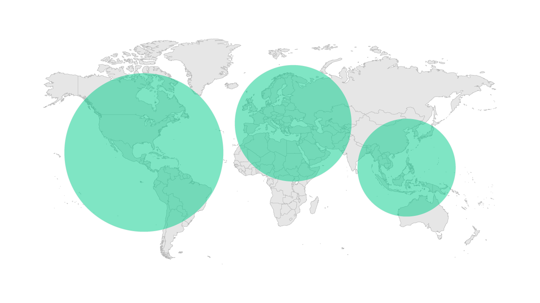
The Trusted Digital Signage Platform
Hospitality
Etc…
Casinos
Auto Dealers
Finance
Airports
QSR
Retail
Transport
500,000
Devices
20
Years Experience
50+
Countries
10,000+
Size of largest network
35%
45%
20%
Offices in Taipei and Los Angeles
Notes:
IAdea is a company that has devoted itself for over 20 years in the evolving digital signage market. To this day, there are around five hundred thousand IAdea devices deployed throughout the world in over 50 countries.
In almost every vertical market where you can find a smart display providing intelligence information to enhance decision making, you are probably likely to find an IAdea device working behind the scene to power the display.

Slide 3
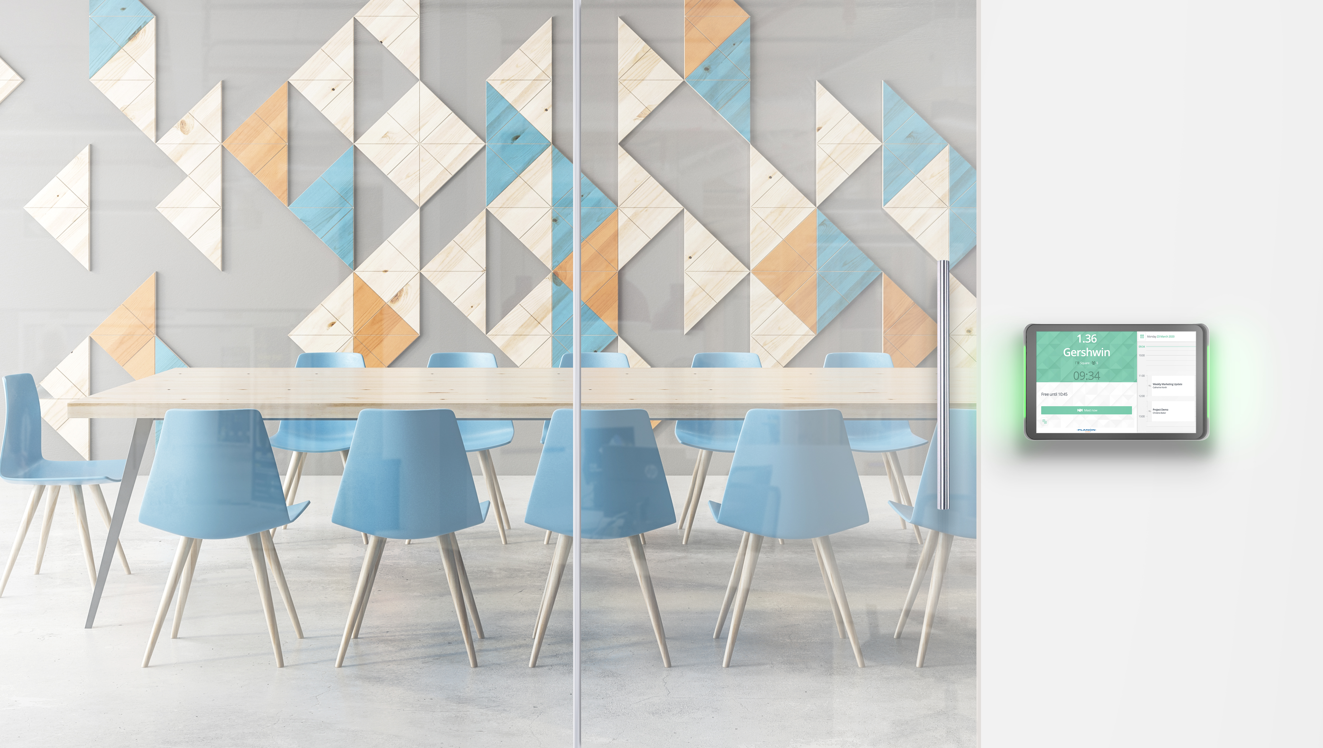



Perfecting the Essentials of Room Management
IAdea Room Booking Technology
SMART & STYLISH
SAFE & STABLE
SECURE & MANAGED
Elegantly designed for the professional workplace. Perfect for immediate room status information.
Purpose-built, tested and certified room booking panels for a professional setting.
Integrates with corporate security infrastructure.
Manage global deployments from any connected workstation.

Slide 4
How Does it Work with Planon?
A One-Stop Shop Experience
Certified and regularly tested by both IAdea and Planon to ensure deliver of a top-notch solution
Software comes pre-loaded, facilitating easy plug and play deployment
Integrated point of contact for support
Planon Connect for IAdea
A jointly developed remote device management plugin that allows user setup, monitoring and device restarts to be executed remotely from within the Planon platform.
IAdea’s visually-appealing integrated displays, combined with the Planon Universe, provide real-time information on meeting room availability.

Slide 5
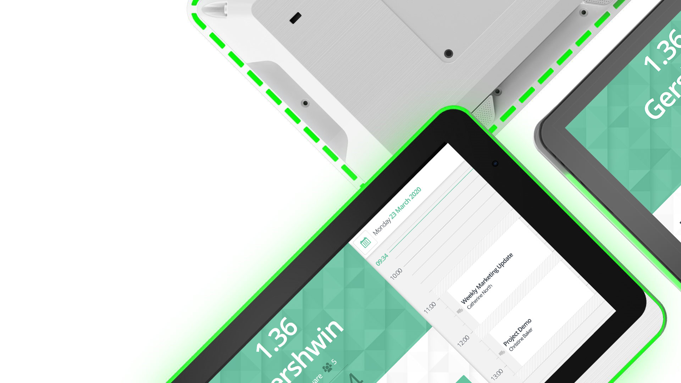
10” and 15”
Enterprise-Grade Room Panel
VARIOUS SCREEN SIZES AND DESIGN OPTIONS

Slide 6
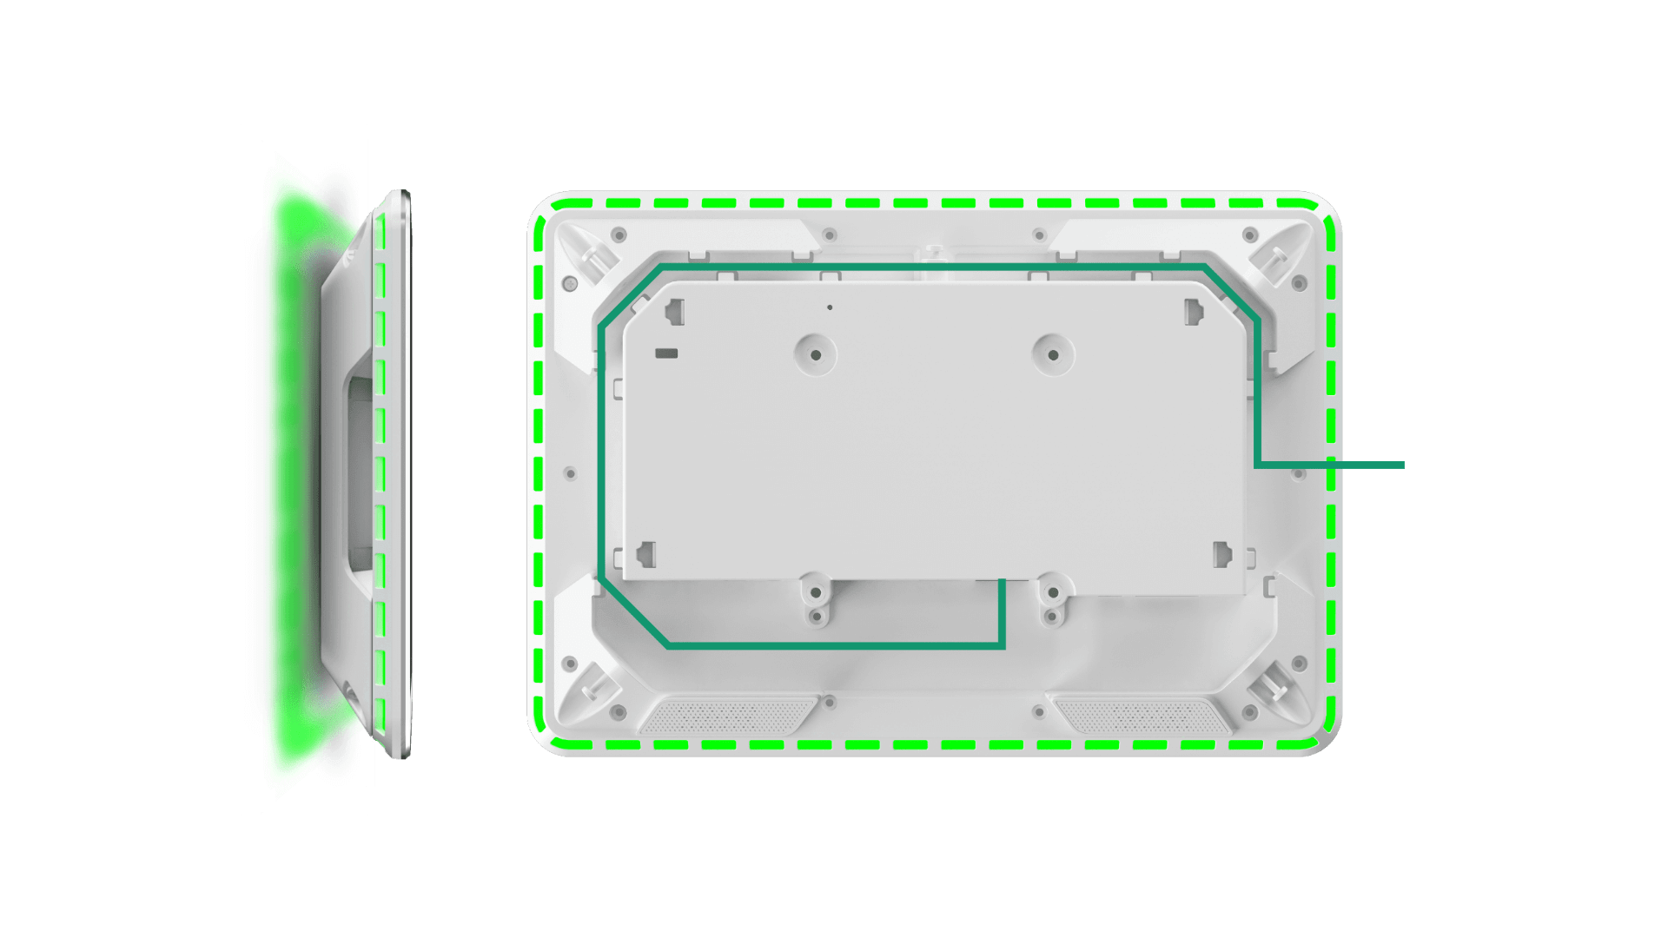
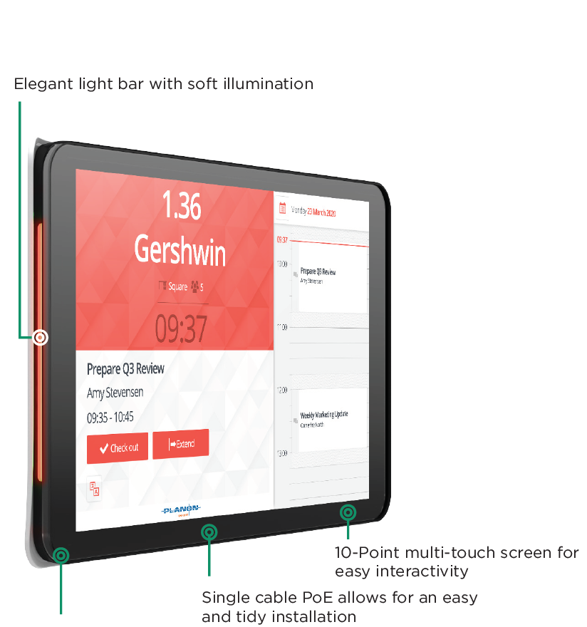

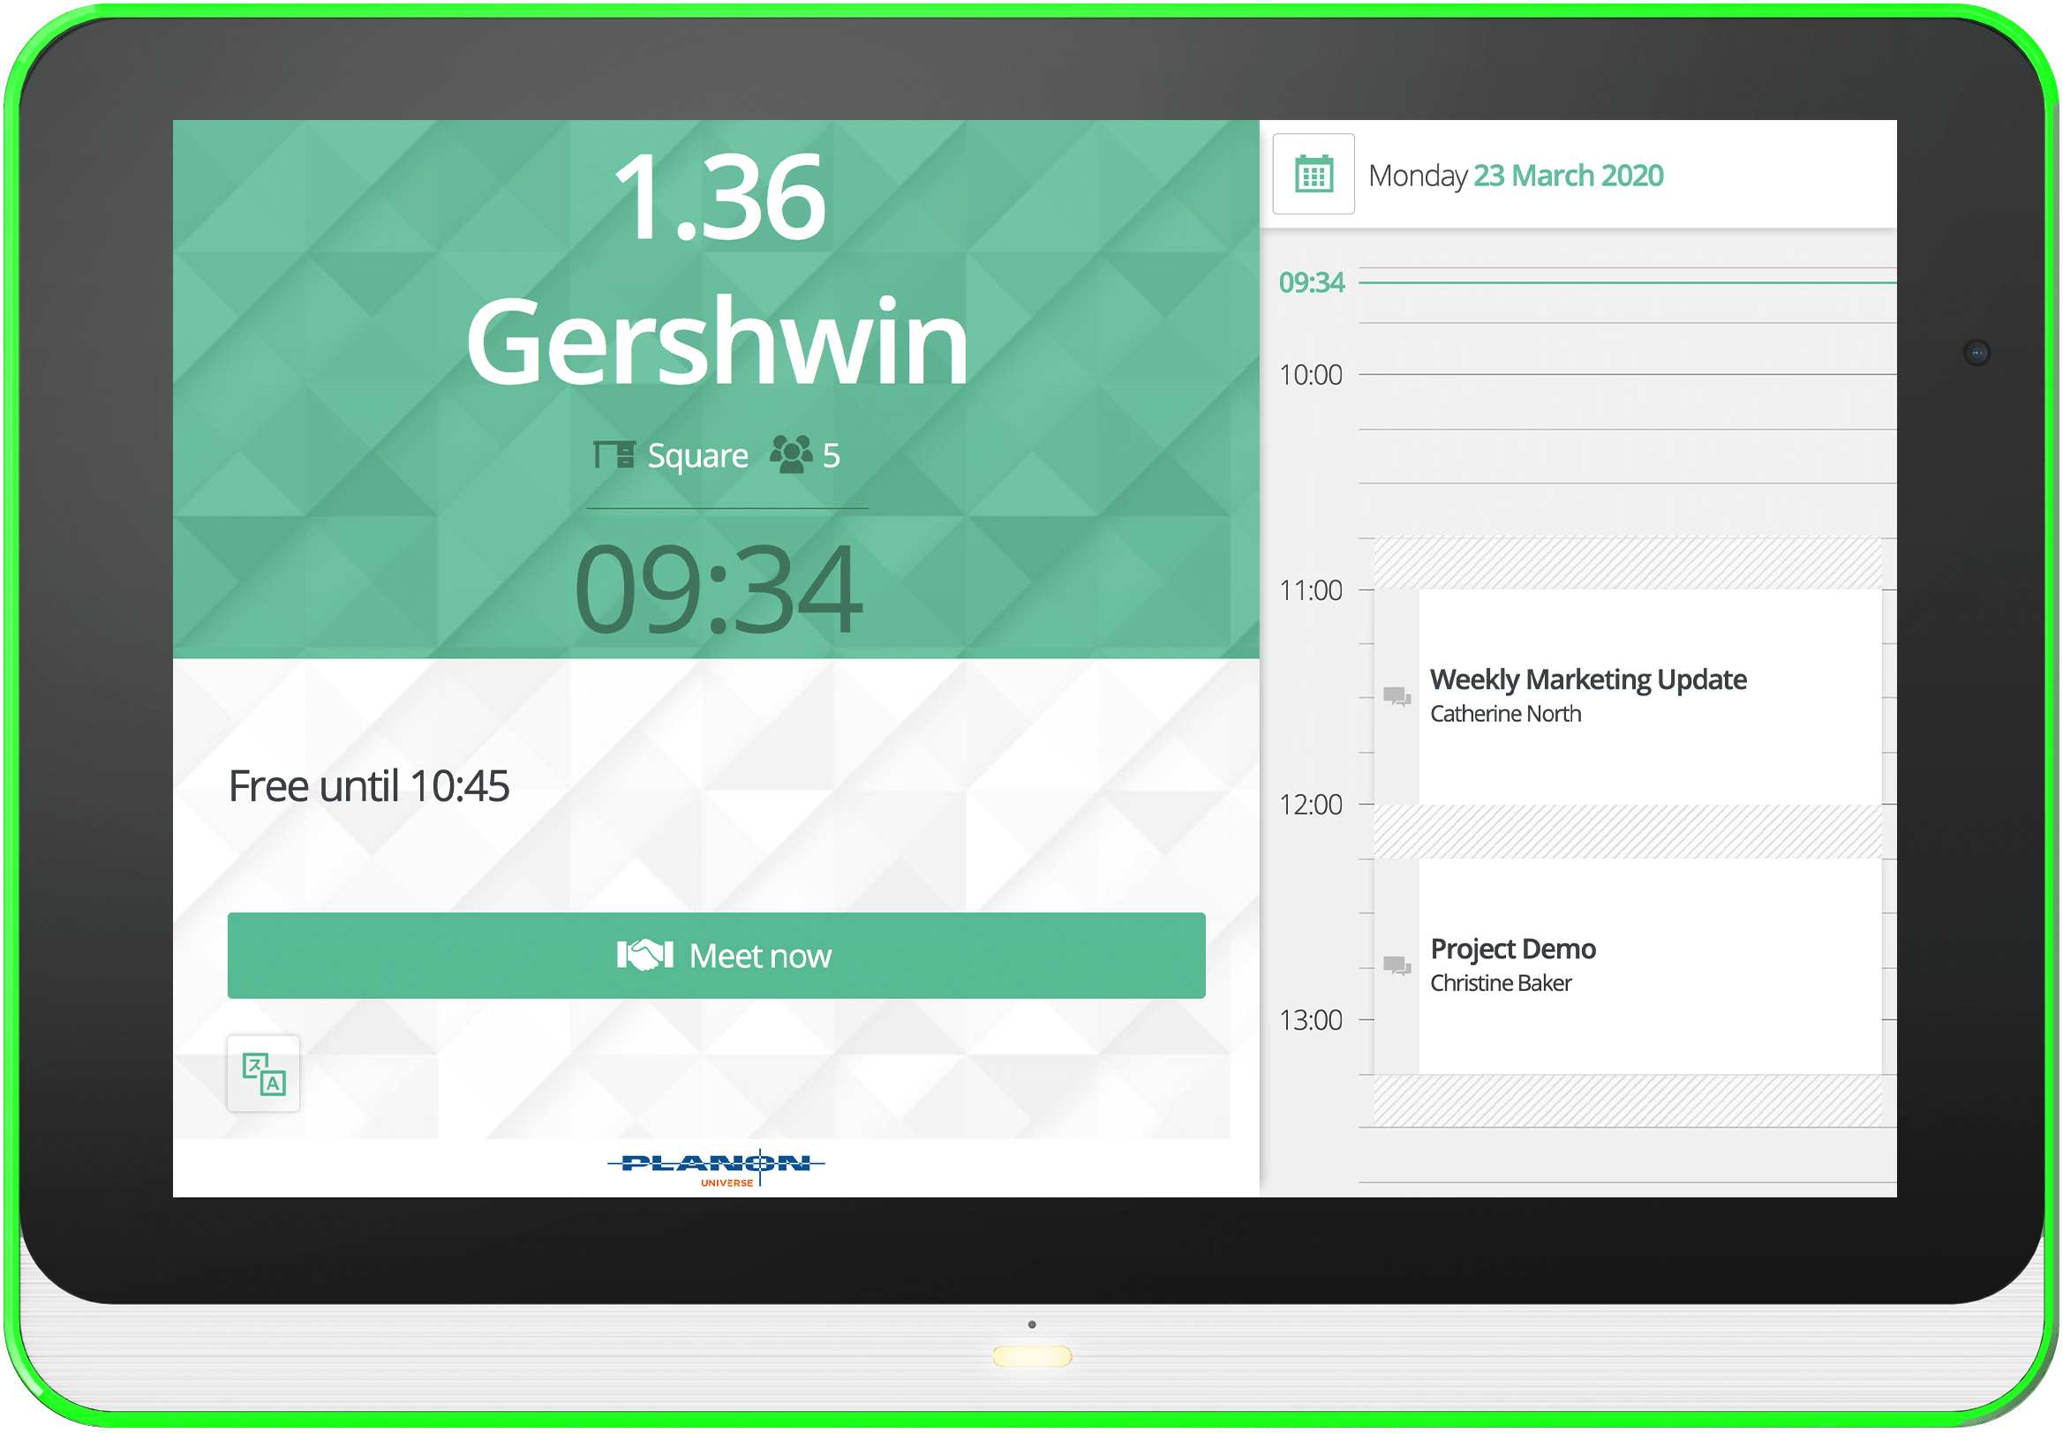
Two different designs: a suitable panel for any workplace interior
Designated space for excess cable storage for tidier mounting
Red for occupied, green for available and yellow for soon-to-be occupied
Model Name: XDS-1078
360°
Status Halo Lighting
Model Name: WRP-1000
Slim design for zero-gap wall, window, or glass mounting options

Slide 7

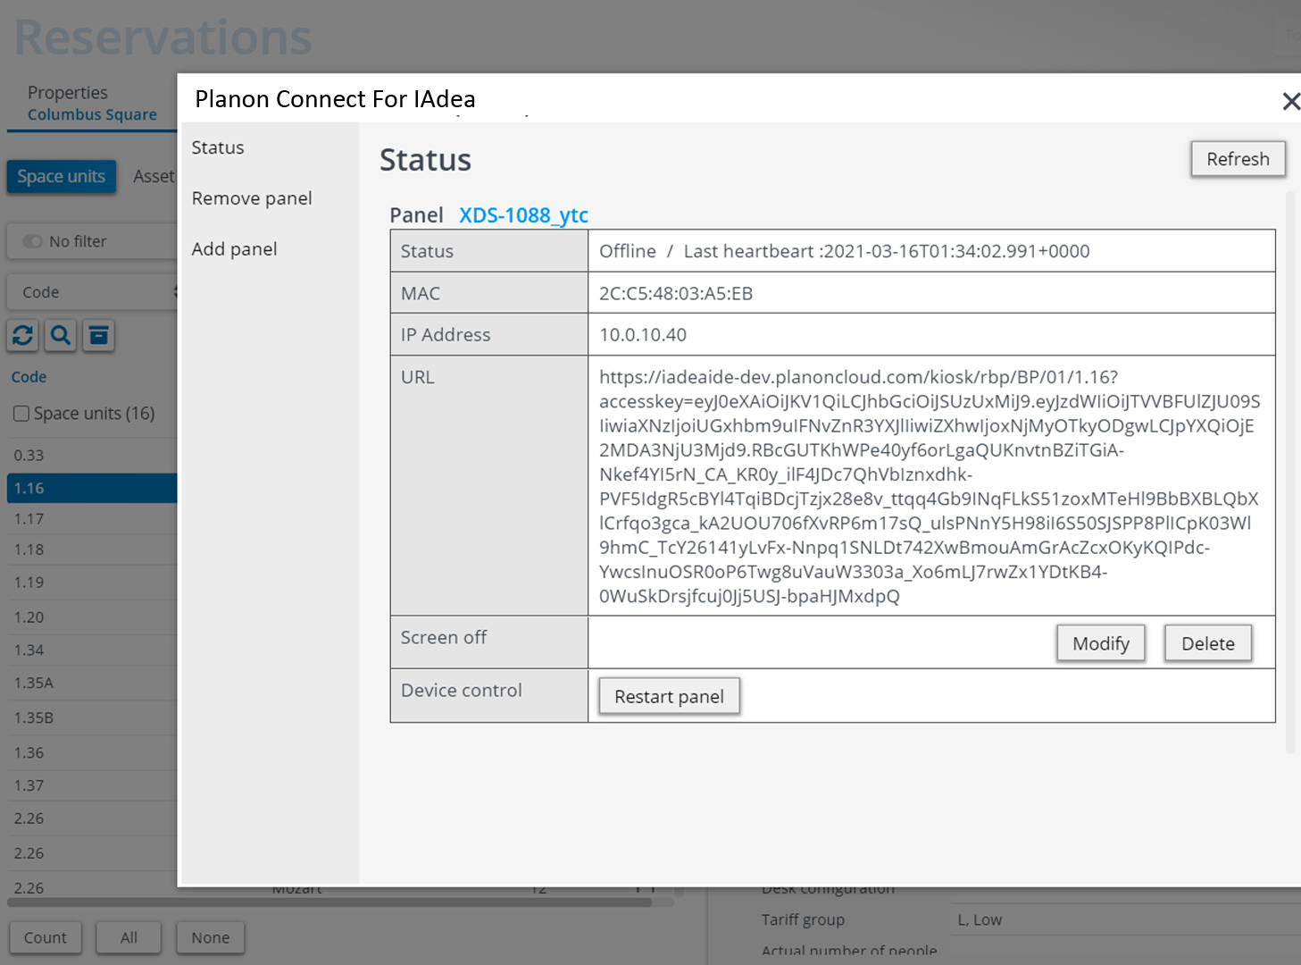
Planon Connect For IAdea
REMOTE DEVICE MANAGEMENT PLATFORM

Slide 8



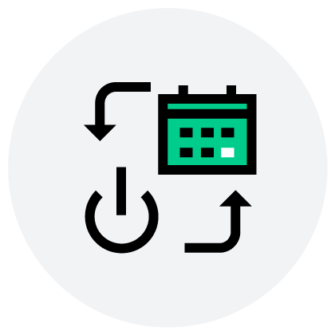
Planon Connect For IAdea
Deploy and Manage Panels Directly from the Cloud
Monitoring Dashboard
An intuitive dashboard with all the need-to-know information (such as device heartbeat, MAC address, etc.) exactly when you need it.
Hassle-Free Remote Restarts
Restart your panel with just the click of a mouse.
Rapid First-Time Setup
Enter the 5-character pairing code and your room booking panel is paired in a matter of moments
Screen On/Off Scheduling
Easily create a schedule for your panels’ screens to automatically switch on and off, no touch necessary, with the added benefit of energy savings.

Slide 9




Why
Product
Durability
Global Reach
System
Manageability
Security
Expertise
01
Solved the “battery bomb” problem
02
Global distribution and universal pricing model
03
Remote device management service
04
IT integration
including SSO and SCEP

Slide 10
Competitive Advantages: Room Panel Series
 | IAdea | Consumer Tablet | Room Control Panel | Signage Tablet
Integrated lighting |  | - |  | 
NFC/HID badge reader |  | - | - | -
Mobile access |  | - | - | -
Built-in PoE (no battery) |  | - |  | 
802.1x security |  | - | - | -
“N-2” Android support |  | - | - | -
Device management |  | - |  | -
Glass mount option |  | - |  | -
SCEP |  | - | - | -
Security audit reports |  | - | - | -
Cost | $$$ | $$ | $$$$ | $$$

Slide 11

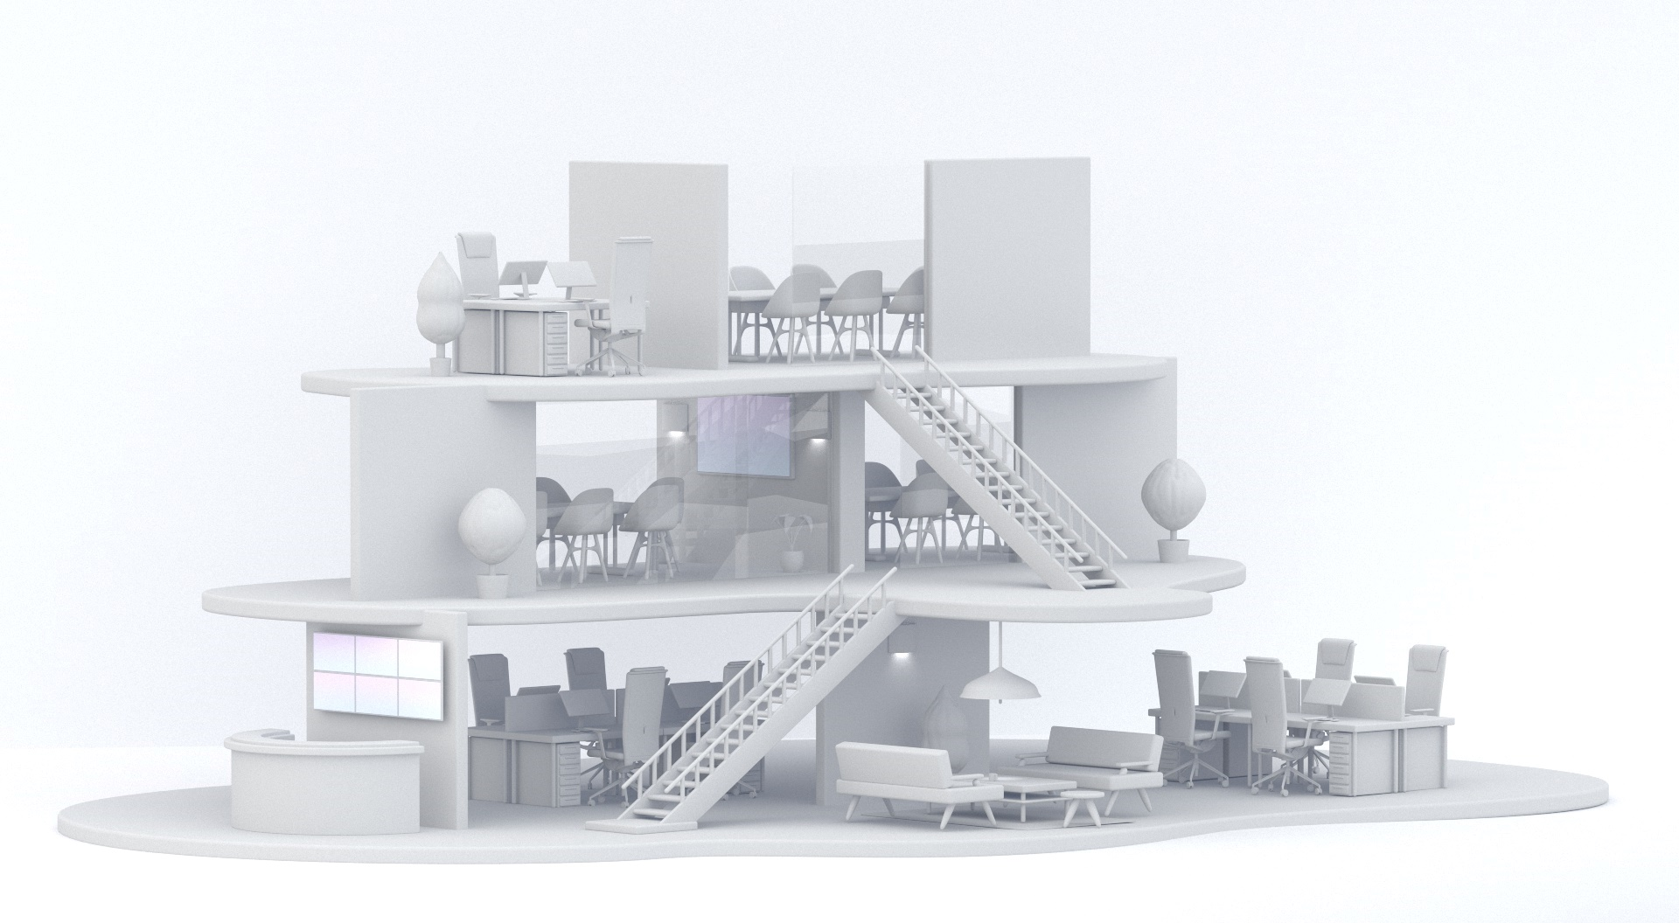





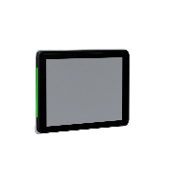
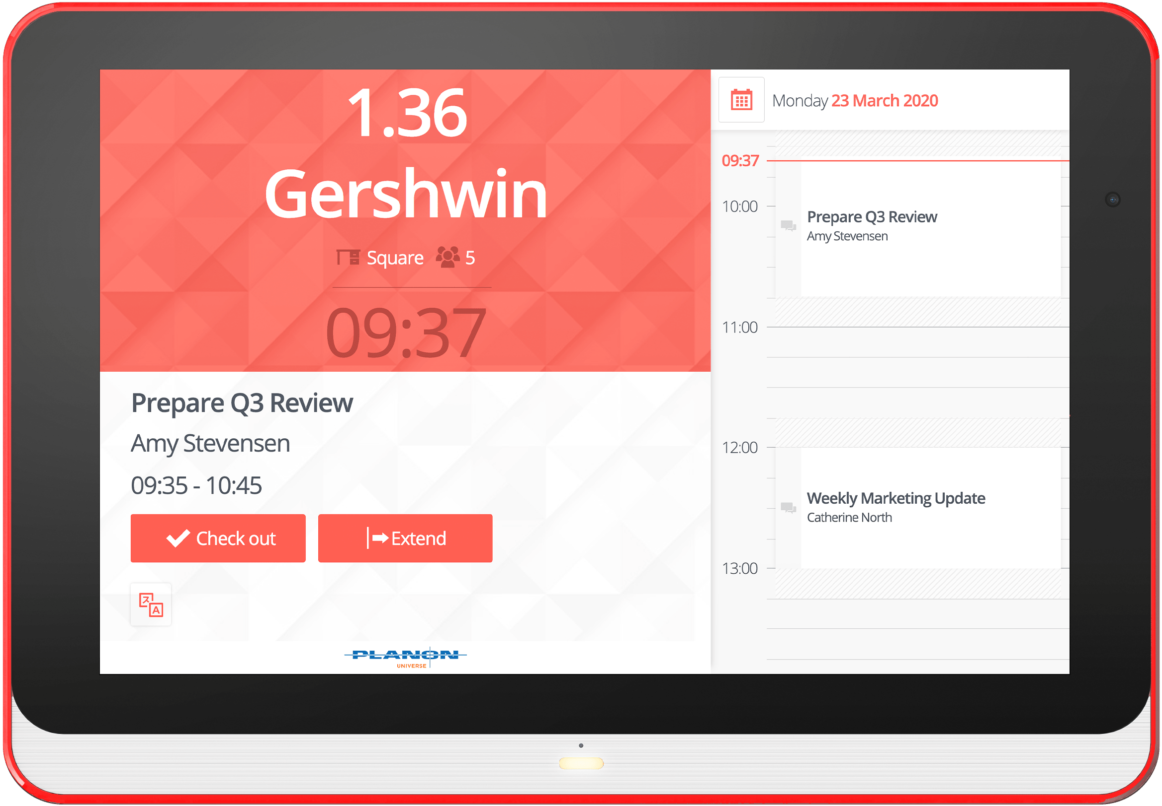


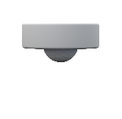




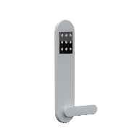
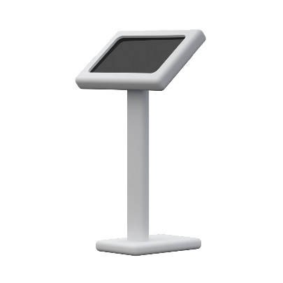
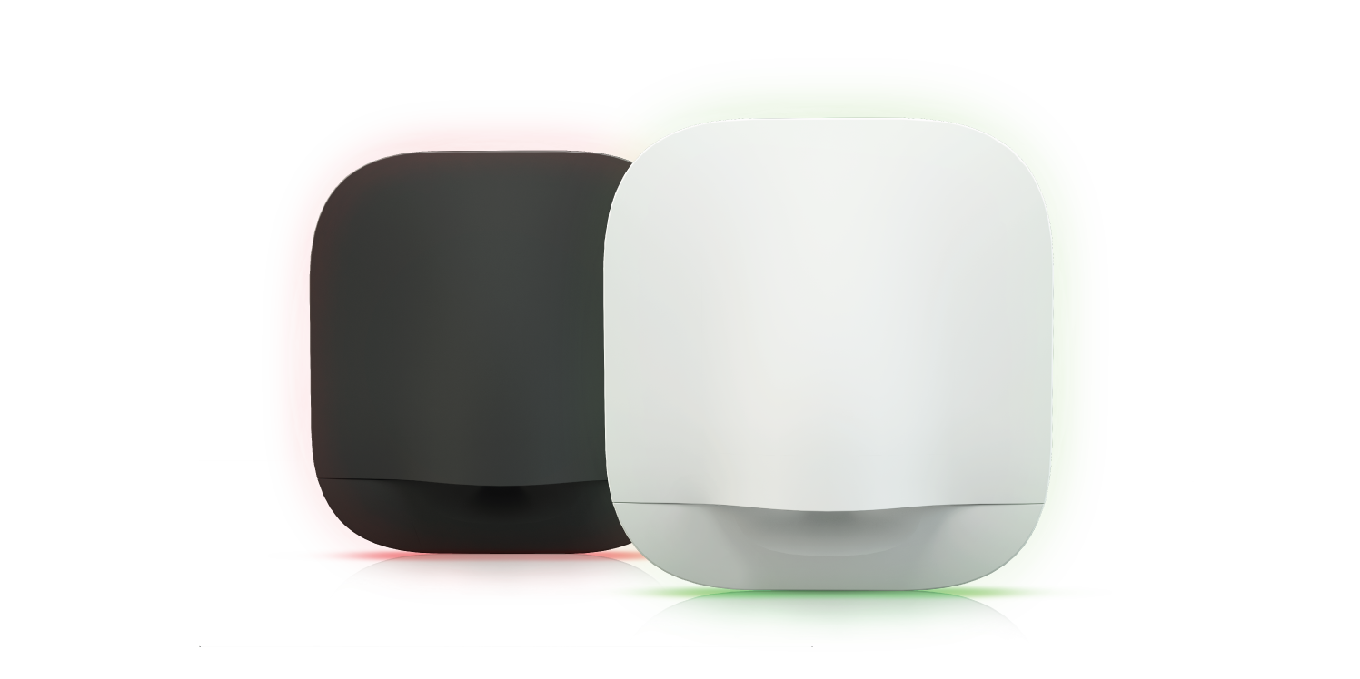
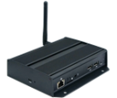




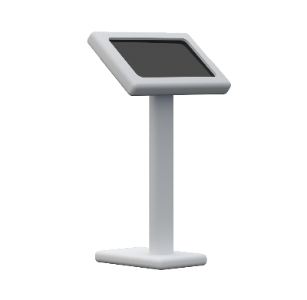


IAdea Solutions for the Smart Workplace
Space Utilization
Workplace Experience
Operational Security
10/15-inch Interactive Room Panel, ID reader options
Remote device management
Information security management system certification
Certified
HID Advantage
Technology Partner
GPIO integration for
sensors and actuators
22-inch way finder Kiosk
Door lock integration for access control
Desk booking device with occupancy sensor, ID reader options
4K interactive
Media player gateway
Infinite video wall
22-inch interactive
desk booking kiosk
External ID reader
Notes:
In this diagram, you got to see how IAdea devices help a typical workplace to reach the three goals that we mentioned earlier.
So for improving work experience, IAdea provides a line of room booking panels which also been certified to work with most of the leading IWMS software.
They are all available in 10 inch and 15 inch sizes for a smaller and larger rooms respectively.
We also provide larger screens that can be used as kiosks. They could enable room finding, wayfinding applications and making it easier to find available rooms when you are at the entrance of a work area.
We also provide digital signage solutions for powering infinitely scalable video walls, using media players.
For improving space utilization, IAdea provides a desk booking device that you can mount on every desk that will provide a color light to indicate the availability of a room. So this is especially useful for flexible workplaces.
The devices, the IAdea provide integrate with various types of sensors and door locks. By having sensors collecting how the rooms are actually used and having the door locks, protecting the assets within the rooms. IAdea devices provide you the entire solution for a secure and managed workplace.
To improve operational security using IAdea technology, we are officially certified by HID as mentioned earlier.
So a lot of the larger enterprises are typically HID clients. So we provide power solutions that comply with HID security requirements and work with your existing cards. IAdea Care provides a remote device management framework that allows you to keep the devices up to day, configured and easily taking care of when a trouble is reported. IAdea is also officially certified to be ISO 27001 compliant. This means we adhere to the latest ISO information standard management system applications and we're able to provide you the full audit report on how our company operates in the security aspect.

Slide 12
Product questions:
Sales@IAdea.com
Technical assistance:
Support@IAdea.com
Contact Us

Slide 13
Appendix

Slide 14


Enterprise-Grade
Data Security
802.1x compliance ensures the IT team have full authority over approving all IAdea devices in the field and prevents unregistered devices from being added to the network
HTTPS protects devices from unauthorized access through automatic encryption of the web interface
ISO 27001 certiﬁcation means all IAdea devices and services meet the highest security requirements
Notes:
Words from Crestron brochure

Slide 15
Product Selection Guide
Product Series | Room Management / Visitor Management Series |  |  |  |  |  | Kiosk | Desk-Hoteling Series |  |  | Digital Signage Series
Model | XDS-1078-A9 | WRP-1000-A | WRP-1000-H | XDS-1588 | XDS-1588-A | XDS-1588-H | XDS-2288 | WDB-001 | WDB-001-A | WDB-001-H | XDS-2285
Screen Size | 10.1" |  |  | 15.6" |  |  | 21.5" | N/A |  |  | 21.5"
Touch | • | • | • | • | • | • | • | • | • | • | -
Light | • | • | • | • | • | • | - | • | • | • | -
PoE | • | • | • | • | • | • | - | • | • | • | -
Wi-Fi | • | • | • | • | • | • | • | • | • | • | •
Bluetooth | • | • | • | • | • | • | • | • | • | • | •
QR Code Scanner | - | • | • | - | - | - | - | - | - | - | -
NFC Card Reader | - | • | • | - | • | • | - | - | • | • | -
HID Card Reader | - | - | • | - | - | • | - | - | - | • | -
Mobile Access | - | - | • | - | - | - | - | - | - | - | -
Door Lock Integration | - | • | • | - | - | - | - | - | - | - | -
CPU | Octa A53 | Octa A53 | Octa A53 | Cortex-A17 | Cortex-A17 | Cortex-A17 | Cortex-A17 | Cortex-A17 | Cortex-A17 | Cortex-A17 | Cortex-A17
Android | 9.0 | 9.0 | 9.0 | 7.1 | 7.1 | 7.1 | 7.1 | 7.1 | 7.1 | 7.1 | 7.1
MOQ | N/A | N/A | N/A | 100 | 100 | 100 | 100 | N/A | N/A | N/A | 100
Lead Time | 1.5 Week | 1.5 Week | 1.5 Week | 10 Weeks | 10 Weeks | 10 Weeks | 10 Weeks | 1.5 Week | 1.5 Week | 1.5 Week | 10 Weeks

